Slide 1
Neural Artistic Style Transfer
Gagandeep (181IT215)
Atharv (181IT208)

Slide 2
Agenda
Introduction
Problem statement
Objectives
Motivation
Literature Survey
Methodology
Result and analysis

Slide 3
INTRODUCTION
Redrawing an art in a certain style is very difficult job when done manually, it requires an expert and also takes up lot of time to complete this task with perfection. We use Convolutional neural network to perform this task.Separating information from style in natural images is still a challenging task. Deep Convolutional Neural Networks have recently made significant advances, resulting in strong computer vision systems that can train to extract high-level structure information from real images. We employ picture representations generated from Convolutional Neural Networks (CNNs) that are optimised for object recognition and make high-level visual in- formation explicit. The algorithm will enable us to generate a new image of high quality with the combination of content of the style of another image. the results obtained at the end of the project will provide us knowledge on how Convolutional Neural Networks develop deep picture representations and show how they may be used for image synthesis and modification.

Slide 4
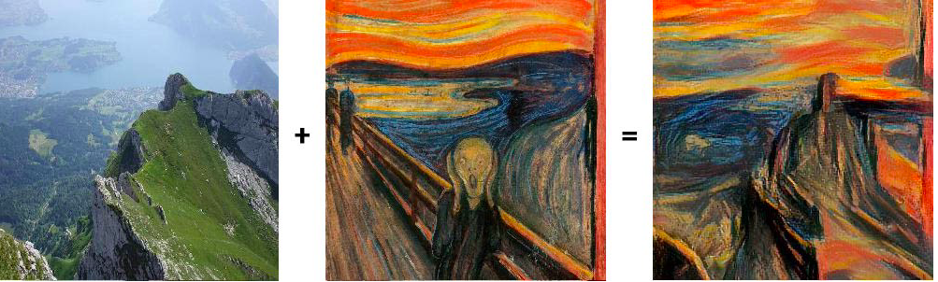
INTRODUCTION

Slide 5
Problem statement
The time taken to redraw an image with certain style takes a lot of work and expertise, so to reduce the time and effort. we are exploring the usage of deep neural networks to produce these re drawn image preserving the quality of the original photograph or drawing.

Slide 6
Objectives
Produce a re-drawn image with a certain style of the original image
Preserve the quality of the output image (re-drawn)
Convert the videos to different style preserving the original structure. Basically applying the same concept to videos
Understand the applications of the work in producing high quality fake images and image modifications.

Slide 7
Motivation
In the era where all the people are fascinated about animations and graphics,crores of rupees are spent on creating high quality graphics and animations.
Many films such as Robot,Avatar and marvel movies have revolutionized the film and entertainment industry
People in India are also realizing the importance of graphics and animation in the field of entertainment
This can make the graphic designing and animation cost effective and can help the small film producers to afford it.

Slide 8
Literature Survey
Deep filter banks for texture recognition, description, and segmentation
Combining Markov Random Fields and Convolutional Neural Networks for Image Synthesis
Predicting Depth, Surface Normals and Semantic Labels with a Common Multi-Scale Convolutional Architecture
Semantic Image Segmentation with Deep Convolutional Nets and Fully Connected CRFs

Slide 9
METHODOLOGY

Slide 10
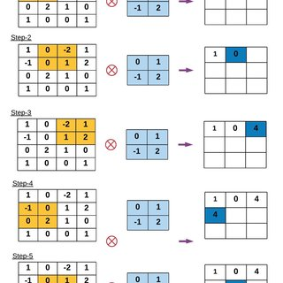
CONVOLUTIONAL NEURAL NETWORK
A Convolutional neural network (CNN) is a neural network that has one or more convolutional layers and are used mainly for image processing, classification, segmentation and also for other auto correlated data.

Slide 11
WHY CNN?

Slide 12
Extraction Of Content From Image
Along the processing hierarchy of the network,the input image is transformed into representations that importantly care about the actual content of the image rather than focussing on the the detailed information about each pixels.
We therefore refer to the feature responses in higher layers of the network as the network representation
The 4_2 convolution layer is used as content extractor.

Slide 13
Extraction Of Style From An Image
To obtain a representation of style of an input image,we use correlations between different filter responses over spatial extent of feature maps.
The main aim here is to capture the color and texture and ignore the content of the image.
The correlation between feature maps is known as gram matrix.
The layers used for calculation of gram matrix are 1_1,2_1,3_1,4_1,5_1 with varied style content for each layer.
This constant can be seen as the constant hyperparameter used for changing style levels.

Slide 14
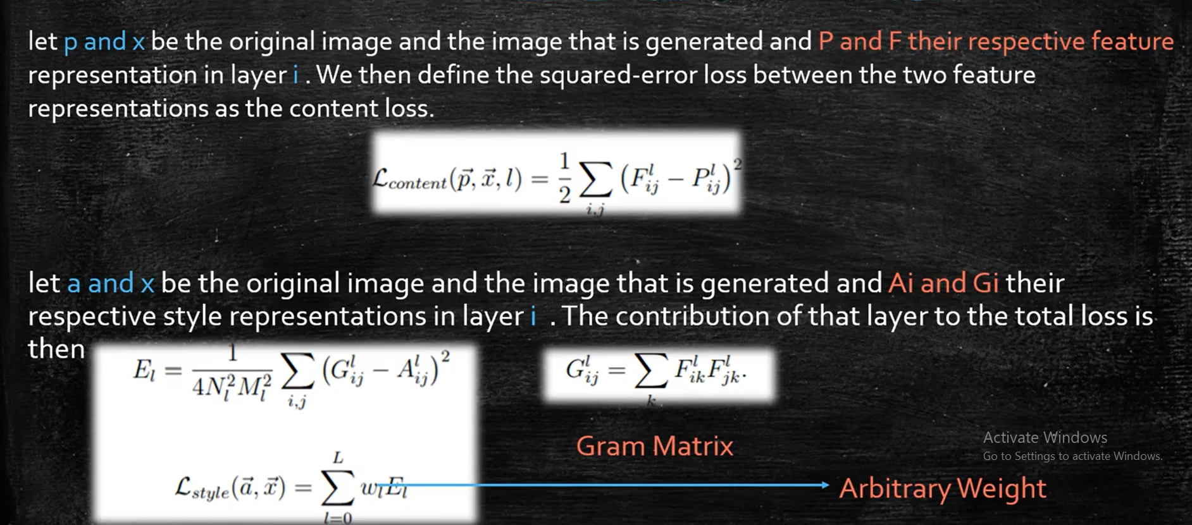
Content Loss And Style Loss

Slide 15
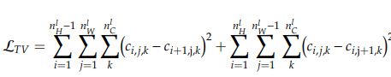
TV loss(The new factor)
This parameter is introduced to make the output image smoother in its texture.
TV loss calculates the square of pixel difference between each pixel and its immediate next pixel in both horizontal and vertical directions
This loss factor improves the sharpness and overall texture of the image.

Slide 16
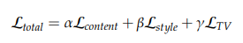
The Total Loss formula Used

Slide 17
RESULTS AND ANALYSIS

Slide 18
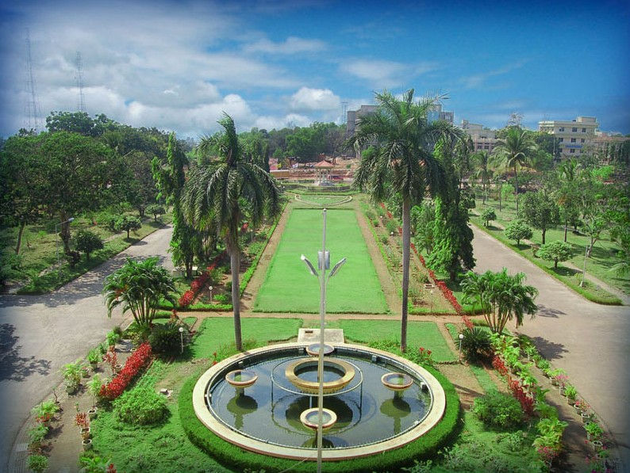
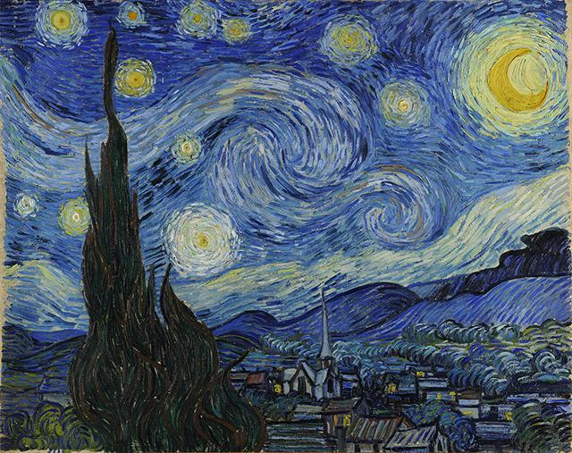
Content image (NITK) + style image

Slide 19
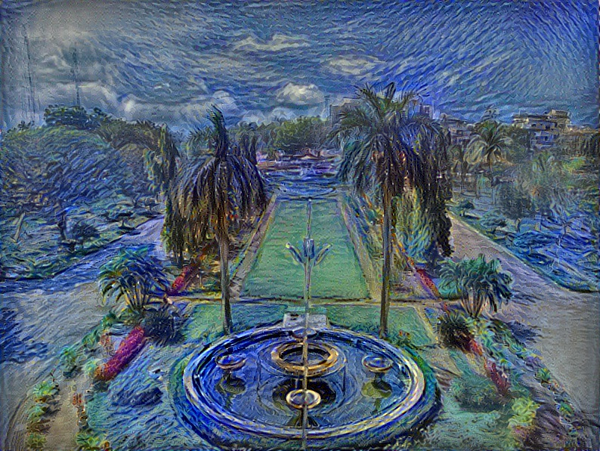

Slide 20
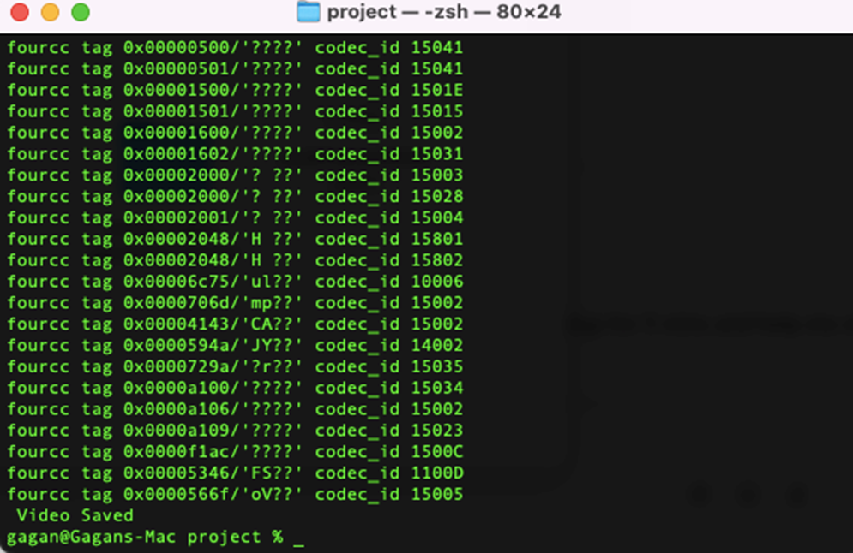
Video results

Slide 21
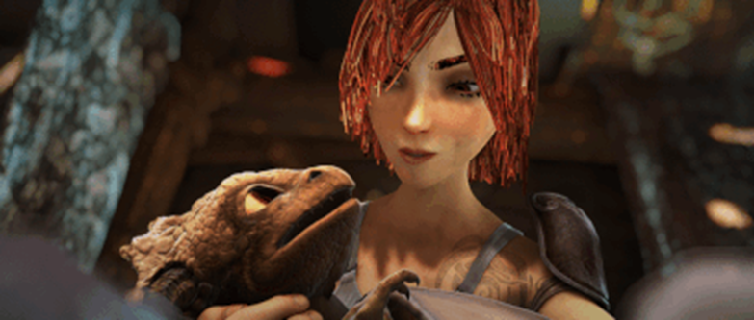
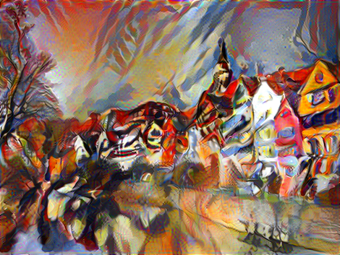
CONTENT VIDEO + STYLE IMAGE

Slide 22
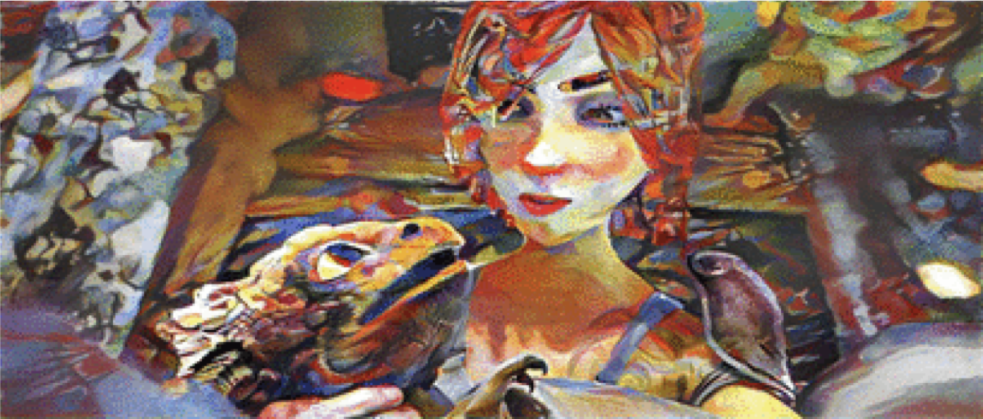

Slide 23
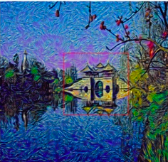
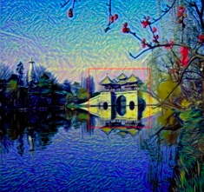
Analysis of TV Loss factor
Without TV Loss factor With TV loss factor

Slide 24
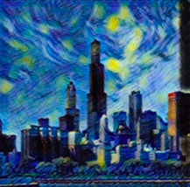
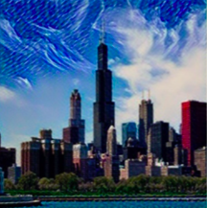
Experimenting with activation functions
Sigmoid function Tanh function

Slide 25
Thank you

